Slide 1
Advanced Python
Lecture 11 Regular Expression / Intro to Tweepy

Slide 2






1st Half Semester
2nd Half Semester
Leverage Python for Data Analytics that is traditionally done through Excel (Table/Formula/Pivot/Macro)
Leverage Python for automation of daily task,
data science module, guest speaker
Week 2: Numpy
Week 3: Pandas Part I
Week 4: Pandas Part II
Week 5: Pandas Part III
Week 6: Visualization
Week 7: Text Processing / Data Integration
Week 8: Midterm Project Presentation
Week 9: Spring Break
Week 10: Python Libraries
Week 11: Regular Expression / Intro to Tweepy
Week 12: Scikit-Learn Part I
Week 13: Scikit-Learn Part II
Week 14: Guest Speaker
Week 15: Final Project Presentation

Slide 3
Regular Expression
Regular Expression: A commonly used text processing library for Python
https://docs.python.org/3/library/re.html
String = “To be or not to be, that is the question”
Pattern = “be”
Search: Find the first occurrence of pattern in the string
Findall: Find all occurrence of pattern
Sub: substitute pattern with something else

Slide 4
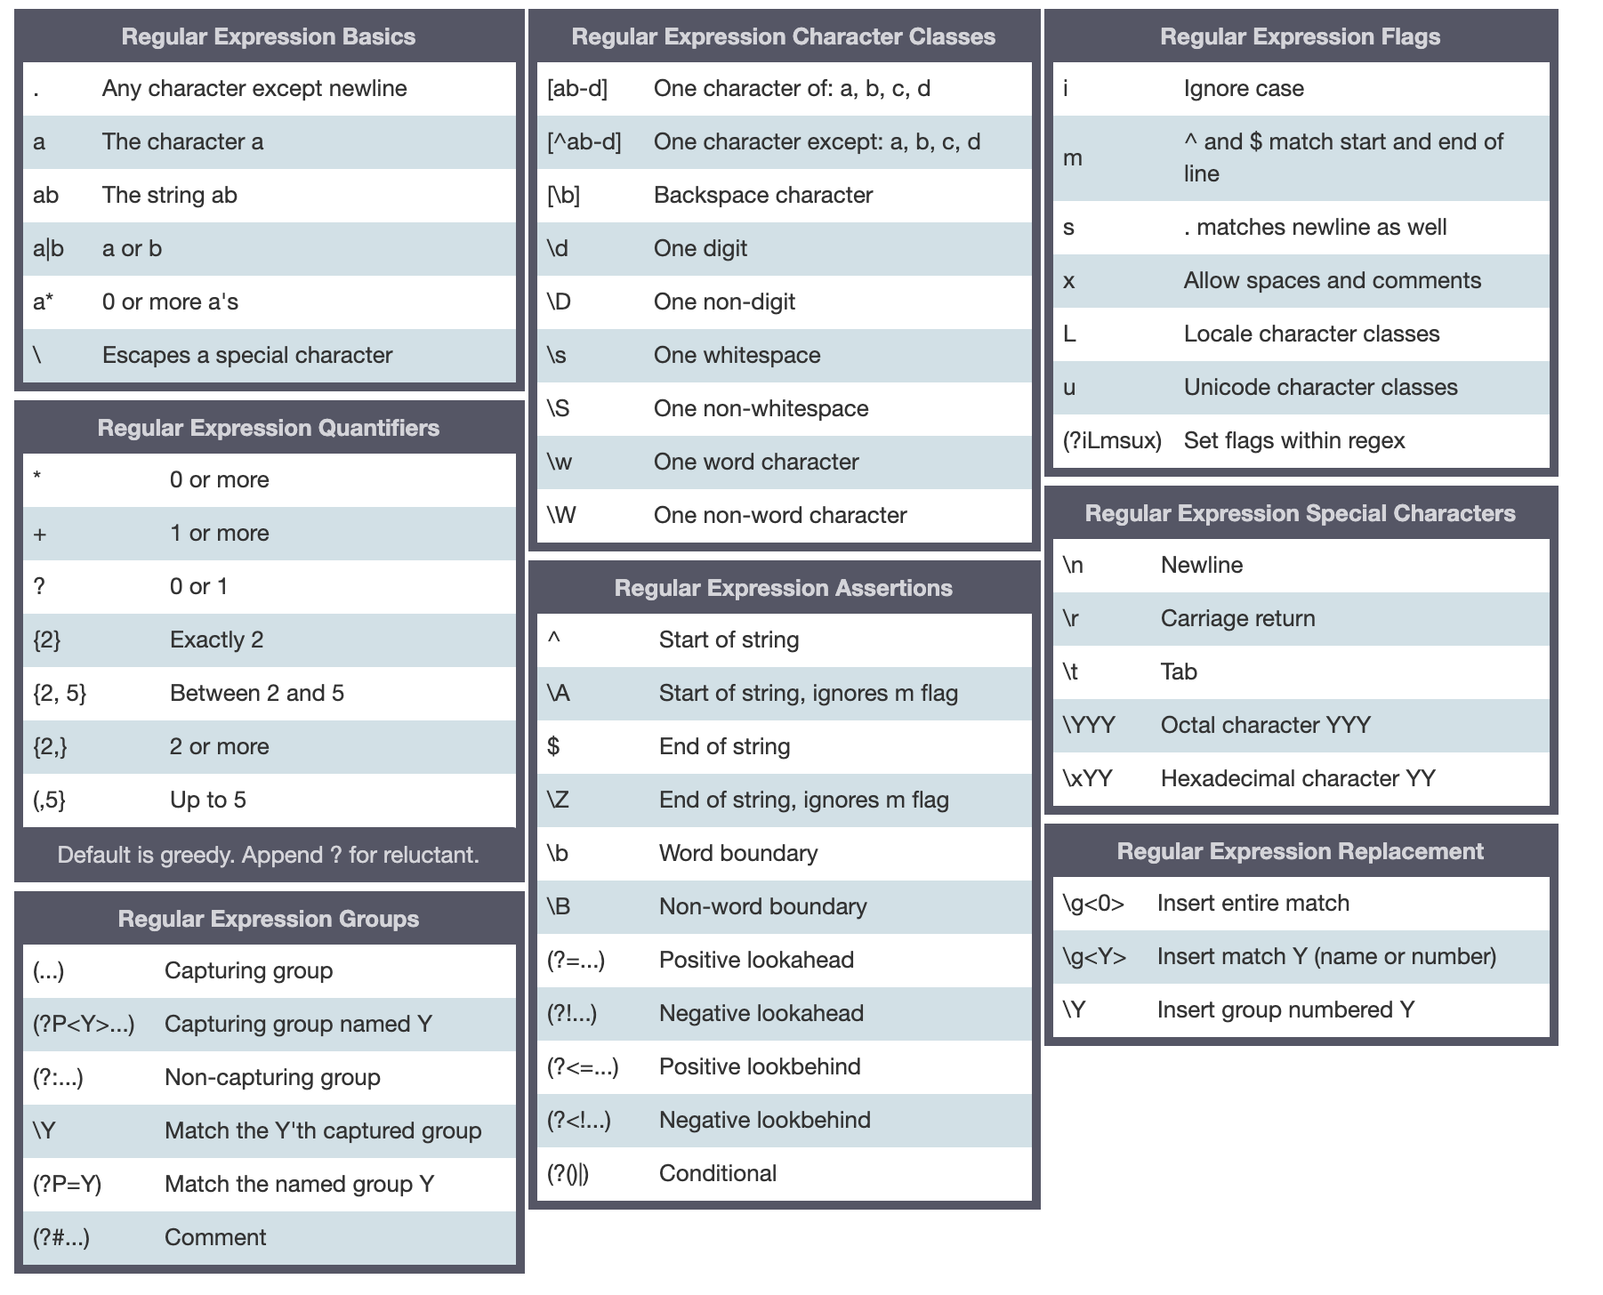
Regular Expression – Cheat Sheet
https://www.debuggex.com/cheatsheet/regex/python

Slide 5
Regular Expression
Phone Number Pattern:
(###)-###-####
###-###-####
###-#######
########## (Depend on context)
(###)#######
\d{3}.\d{3}.\d{4}
3 digits, some character, then another 3 digits, some character, then another 4 digit
\d{10}
10 digits in a row
\d{3} .\d{7}
3 digit, some character, then another 7 digits
Email Pattern:
AAAAA@AAA.com
Need to have some non space character, then @ symbol, some more non space character, then dot, then some more non space character
\S+@\S+
At least one none white space characters, @ symbol,
Some none white space characters

Slide 6


Regular Expression
Pickle
Leverage tweepy to pull live tweet data
Save / Load Python variables as a file (e.g., DataFrames)
Command Your Own Tweets
Pull Tweets from a person
Pull Follower / Following from a person
Pull popular tweets based on key search term

